Slide 1
Getting Bail: Working with the latest Bail Act
Jason Hale
Hunter Street Chambers
4032 4511
www.hunterstreetchambers.com.au
September 2014

Slide 2
Key Points
3 keys points for today’s discussion
Unacceptable Risk
Mitigating the Risk
Some authorities

Slide 3
Introduction and context…
Old Bail Act 1978
Difficult, confusing, complex
Since 1978 has been amended by over 80 other Acts
Offence based presumptions:
Presumptions against bail
In favour of bail
Neutral

Slide 4
Introduction and context…
2011 – NSW Government announces a review of the Bail Act
Review to be undertaken by the NSWLRC
39 submissions from NSW Law Society, Bar Association, NSW Police Force and the Association, members of the community
Most were critical of the Act
Unnecessarily complex
Confusing
Used by the police as a form of punishment

Slide 5
Introduction and context…
2013 – NSWLRC publishes its 408 page final report
Recommends removal of the presumptions regarding bail
These to be replaced by a uniform presumption in favour of release in all cases
The new legislation would be ‘risk based’
Accused represents an unacceptable risk that cannot be mitigated by bail conditions then bail will be refused

Slide 6
The new Bail Act 2013…
Passed 22 May 2013
Commenced 20 May this year

Slide 7
Its Purpose – section 3…
To provide a legislative framework for a decision as to whether a person who is accused of an offence or is otherwise required to appear before a court should be detained or released, with or without conditions.

Slide 8
Its Purpose – section 3…
In making a decision under the Act, a bail authority is to have regard to the presumption of innocence and the general right of a person to be at liberty
Interesting in the light of proposed changes

Slide 9
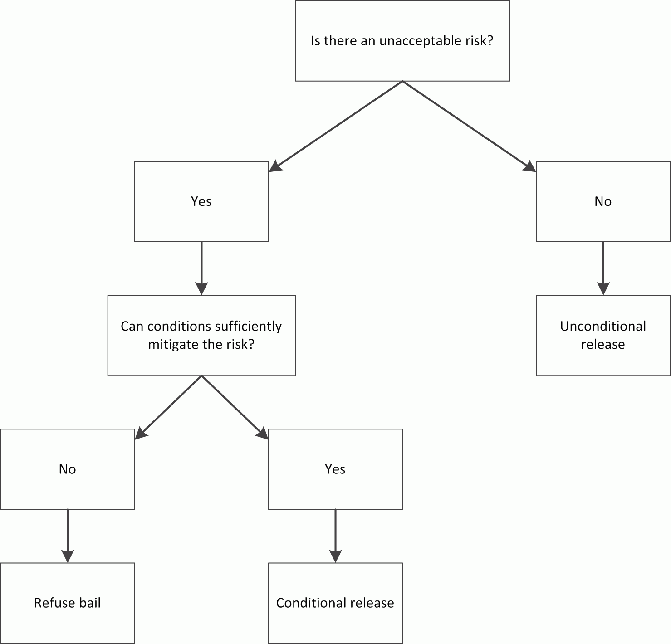
Flow Chart – The Bail Decision – section 16

Slide 10
The decision making process – sections 17 and 20
Two stages:
Are there any UNACCEPTABLE RISKS?
If so, can they be MITIGATED?

Slide 11
Unacceptable Risk…
Definition – section 17(2)
A risk is unacceptable where an accused person, if released from custody will:
fail to appear at any proceedings for the offence, or
commit a serious offence, or
endanger the safety of victims, individuals or the community or,
interfere with witnesses.

Slide 12
Unacceptable Risk…section 17(3)
It is important to remember that when a bail authority is deciding whether there is an unacceptable risk, it can ONLY take into account the following:
an accused person’s background, including criminal history, circumstances and community ties
the nature and seriousness of the offence
the strength of the prosecution case
whether the accused has a history of violence

Slide 13
Unacceptable Risk…section 17(3)
whether the accused has previously committed a serious offence while on bail
whether the accused person has a pattern of non-compliance with bail acknowledgments, bail conditions, apprehended violence orders, parole orders or good behaviour bonds
the length of time the accused person is likely to spend in custody if bail is refused
the likelihood of a custodial sentence being imposed if the accused person is convicted of the offence

Slide 14
Unacceptable Risk…section 17(3)
if the accused person has been convicted of the offence and proceedings on an appeal against conviction or sentence are pending before a court, whether the appeal has a reasonably arguable prospect of success
any special vulnerability or needs the accused person has including because of youth, being an Aboriginal or Torres Strait Islander, or having a cognitive or mental health impairment

Slide 15
Unacceptable Risk…section 17(3)
the need for the accused person to be free to prepare for their appearance in court or to obtain legal advice, and
the need for the accused person to be free for any other lawful reason.

Slide 16
What is a serious offence?
Not defined in the Act
Section 17(4) gives us some guidance - the matters that are to be considered are:
whether the offence is of a sexual or violent nature or involves the possession or use of an offensive weapon or instrument within the meaning of the Crimes Act 1900

Slide 17
Serious offence continued
the likely effect of the offence on any victim and on the community generally
the number of offences likely to be committed or for which the person has been granted bail or released on parole
Remember that these matters are not restrictive

Slide 18
Type of bail decisions where there is no unacceptable risk – section 18
Release a person without bail
Dispense with bail
Grant bail without conditions

Slide 19
Unacceptable risk – some authorities
The unacceptable risk test has been around in other jurisdictions for some time
Victorian Bail Act 1997 – section 4(2)(d)
Haidy v DPP [2004] VSC 247 – looked at this section
Haidy charged with serious drug and weapons offences
At the time of these offences he was on bail for other serious drug offences

Slide 20
Haidy v DPP [2004] VSC 247
Redlich J summarised the authorities:
Bail is not risk free
Because a person’s liberty is at stake, suspicion or fear of the worst possibility if the offender is released is not sufficient
Not necessary for prosecution to establish that the occurrence of the event constituting the risk is more probable than not
What must be established is that there is a sufficient likelihood of the occurrence of the risk and taking into account all the relevant circumstances, the risk is unacceptable

Slide 21
Mitigating the risk – section 20
The only way a risk can be mitigated is by the imposition of bail conditions
If there is an unacceptable risk that cannot be mitigated then bail may be refused
It follows then that if bail conditions can sufficiently mitigate the risk, then bail conditions can be imposed and the person released on bail

Slide 22
General rules on bail conditions – section 24
A bail condition can be imposed only for the purpose of mitigating an unacceptable risk
Bail conditions must be reasonable, proportionate to the offence for which bail is granted, and appropriate to the unacceptable risk in relation to which they are imposed

Slide 23
General rules on bail conditions – section 24
A bail condition is not to be more onerous than necessary to mitigate the unacceptable risk in relation to which the condition is imposed
Compliance with a bail condition must be reasonably practicable
This section does not apply to enforcement conditions

Slide 24
Types of bail conditions
Impose conduct requirements (requiring a person to do something or refrain from doing something) – section 25
Require security to be provided – section 26
Require character acknowledgments - section 27

Slide 25
Types of bail conditions
Impose accommodation requirements (generally for children only) – section 28
Impose pre-release requirements (surrender passport, provision of security, character acknowledgment) – section 29

Slide 26
Enforcement conditions – section 30
These are additional to the bail conditions
Enforcement conditions are imposed for the purpose of monitoring or enforcing compliance with another bail condition.
An enforcement condition requires the person given bail to comply with a specific type of police direction, for example requiring a person to abstain from drugs or alcohol or to comply with a curfew

Slide 27
Enforcement conditions – section 30
Can only be imposed by the court if the court considers it ‘reasonably and necessary’ in the circumstances
The court must have regard to the following:
the history of the person granted bail
the likelihood or risk of the person committing further offences while at liberty on bail
the extent to which compliance with a direction of a kind specified in the condition may unreasonably affect persons other than the person granted bail

Slide 28
Enforcement conditions – sections 30 and 81
Remember only the prosecutor can request enforcement conditions
Section 81 – giving directions under enforcement conditions
A police officer may give a direction of a kind specified in the enforcement condition
‘Tip’ - What do to if police are over the top in enforcing the condition
for example a curfew?

Slide 29
Types of applications
Release application which is made by an accused – section 49
Detention application made by a prosecutor – section 50
Variation application which can be made by an interested person.
An interested person includes the accused, a prosecutor, a complainant in a domestic violence offence, a PINOP in AVO matters and the Attorney General – section 51

Slide 30
NSW Authorities
Onus of proof is on the prosecution
R v Lago [2014] NSWSC 660
Lago was charged with aggravated break, enter and steal offence and firearms offences.
In referring to section 20 of the Act and the refusal of bail if bail conditions cannot sufficiently mitigate the unacceptable risk, Hamill J stated that the onus of proof is on the party who opposes bail.
The court granted bail with conditions.

Slide 31
NSW Authorities – the straw that broke the camel’s back?
Murder – applicant awaiting re-trial
R v Hawi [2014] NSWSC 837
Hawi was charged with murder as a result of a brawl at Sydney Airport
The brawl was between rival outlaw motorcycle gangs. He was convicted but the conviction was set side and the court of criminal appeal ordered a new trial

Slide 32
NSW Authorities – the straw that broke the camel’s back?
The bail application was heard before Harrison J
His Honour found that there were a number of unacceptable risks including a risk that Hawi would endanger the safety of individuals and the community
and the associated risk of committing a serious offence

Slide 33
NSW Authorities – the straw that broke the camel’s back?
His Honour was ultimately satisfied that these risks could be mitigated by the imposition of the following strict conditions:
To be of good behaviour.
To live at xxx.
Reporting to police
Curfew
A person agreeing to forfeit $500,000.00
Another person agreeing for forfeit $200,000.00
And others listed in the paper

Slide 34
Where to now?
Perception in the community that people were getting bail that shouldn’t have
Pushed by police and media
Government orders a review of the Act
New proposals likely to include
Special category for serious offences – the onus will be on the accused to ‘show cause’ as to why he or she should be given bail

